Slide 1
FINANCIAL ANALYSIS OF DIFFERENT STATES (INDIA)
MASAI SCHOOL

Slide 2


PROJECT TEAM MEMBERS
PIYUSH RAMGIRWAR SUDARSHAN ATRE
( PD15_017 ) ANUSHA DUDDUKURU ( PD14_212 )
( PD15_130 )

Slide 3
AVAILABLE DATA FOR THE FINANCIAL ANALYSIS
1.AGGREGATE EXPENDITURE
2.CAPITAL EXPENDITURE
3.GROSS FISCAL DEFICITS
4.NOMINAL GSDP SERIES
5.OWN TAX REVENUE
6.REVENUE EXPENDITURES
7.REVENUE DEFICITS
8.SOCIAL SECTOR EXPENDITURES

Slide 4
TOOL USED FOR ANALYSIS AND VISUALISATION
1.SQL (DATA CLEANING AND ANALYSIS)
2.EXCEL (DATA ANALYSIS AND VISUALISATION)

Slide 5
AGGREGATE EXPENDITURE
VALUE OF ALL FINISHED GOODS AND SERVICES AT A GIVEN TIME WITHIN AN ECONOMY
IT IS USUALLY CALCULATED WITHIN A CONTEXT OF A YEAR
SO WE HAVE TAKEN SUM OF 5 YEARS
AGGREGATE EXPENDITURE CAN BE USED TO CALCULATE THE GDP (GROSS DOMESTIC PRODUCT)

Slide 6
CAPITAL EXPENDITURE
MONEY SPEND FROM THE GIVEN FUND FROM THE STATE GOVT.

Slide 7
GROSS FISCAL DEFICIT
IT IS NOTHING BUT IT IS THE DIFFERENCE BETWEEN THE EARNING OF ANY STATE TO THE AMOUNT WHICH THEY ARE SPENDING IN TERMS OF DOLLARS AND RUPEES FOR THE GOVT.PROJECTS
EARNINGS LESS SPENDING MORE THAT IS FISCAL DEFICIT .

Slide 8
GSDP - GROSS STATE DOMESTIC PRODUCT.
RELATED TO MONEY
MEASURES THE SUM OF TOTAL ALL FINISHED GOODS AND SERVICES MEANS IT SHOWS THE MARKET VALUE OF GOODS AND PRODUCTS DURING A GIVEN PEROID OF ONE YEARS

Slide 9
NOMINAL GSDP
IT SHOWS THE SUGGESTED VALUE OF GOODS AND FINISHED PRODUCT.

Slide 10
OWN TAX REVENUE
INCOME GAIN BY GOVT. IN TAXATION STATE SHOWS 70% OF TOTAL TAX REVENUE AND ITS COMPONENTS SHOWS THE GROWTH

Slide 11
REVENUE DEFICITS
THE ACCESS OF EXPENSES OVER RECIPITS ON REVENUE ACCOUNT IS CALLED REVENUE DEFICITSSPENDING MORE THEN EARNING FROM THE REVENUE OR TAXES

Slide 12
REVENUE EXPENDITURE
REVENUE EXPENDITURE IS EXPENDITURE WHICH DOES NOT RESULT IN CREATION ASSEST.
IN SIMPLE MEANS GOVT. IS USING AMOUNT IN PUBLIC PROPERTY WELFARE FOR DEVELOPING ROADS STREET LIGHT

Slide 13
SOCIAL SECTOR EXPENDITURE
ID INCLUDES EXPENDITURE LIKE ON SOCIAL SERVICES LIKE RURAL DEVELOPMENT , FOOD STORAGE , WAREHOUSES UNDER REVENUE EXPENDITURE.

Slide 14
INSIGHTS
TOP STATES ACCORDING TO EACH FINANCIAL METRICS
CORELATION BETWEEN CAPITALEXPENDITURE AND GROSS FISCAL DEFICITS
CORELATION BETWEEN SOCIAL SECTOR EXPENDITURES AND TAX REVENUE
TOP10 STATES WITH HIGHEST GROSS
FISCAL DEFISITS
GROSS FISCAL DEFICITS TREND FOR
EACH STATES.
TOP 2 STATES AS PER UPWARD AND DOWNWARD TRENDS FOR GROSS FISCAL DEFICITS.
NOMINAL GSDP TREND FOR EACH STATES.
TOP 2 STATES AS PER UPWARD AND DOWNWARD TREND FORNOMINAL GSDP SERIES

Slide 15
KPI’s
Own Tax Revenue
Revenue Deficits

Slide 16
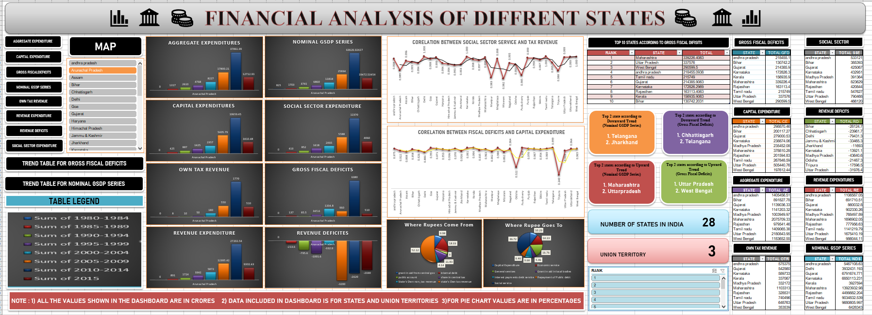
DASHBOARD

Slide 17
CHALLENGES FACED
UNDERSTANDING THE FINANCIAL METRICS
DATA IMPORTING
DATA MANIPULATION USING SQL

Slide 18
Thank you…!

